Slide 1
Capstone Project - 5
BOOK RECOMMENDATION SYSTEM
Amol Rakhunde

Slide 2
Content
Problem statement
Data Summary
Analysis of different datasets
Data Cleaning
Outlier treatment
Imputing missing values
Different Recommendation Model
Challenges
Conclusion
Future Scope

Slide 3

Problem Statement
During the last few decades, with the rise of Youtube, Amazon, Netflix, and many other such web services, recommender systems have become much more important in our lives in terms of providing highly personalized and relevant content.
The main objective is to create a recommendation system to recommend relevant books to users based on popularity and user interests.

Slide 4
Data Summary
The dataset is comprised of three csv files:: User_df, Books_df, Ratings_df
Users_dataset.
User-ID (unique for each user)
Location (contains city, state and country separated by commas)
Age Shape of Dataset - (278858, 3)
Books_dataset.
ISBN (unique for each book)
Book-Title
Book-Author
Year-Of-Publication
Publisher
Ratings_dataset.
User-ID
ISBN
Image-URL-S
Image-URL-M
Image-URL-L
Shape of Dataset - (271360, 8)
Book-Rating
Shape of Dataset - (1149780, 3)

Slide 5
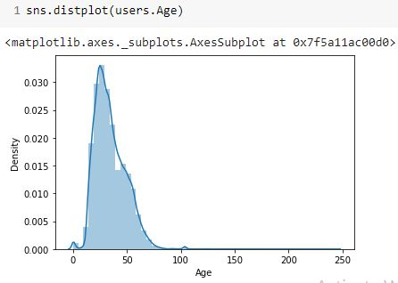
Observations from Users_df (Age)
The Age range given here is from 0
To 250.
Outliers in the Age column.

Slide 6
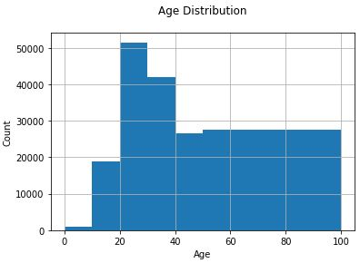
Observations from Users_df (Age)
The Age range distribution is
right skewed
Most active readers lie in age
group 20- 40

Slide 7
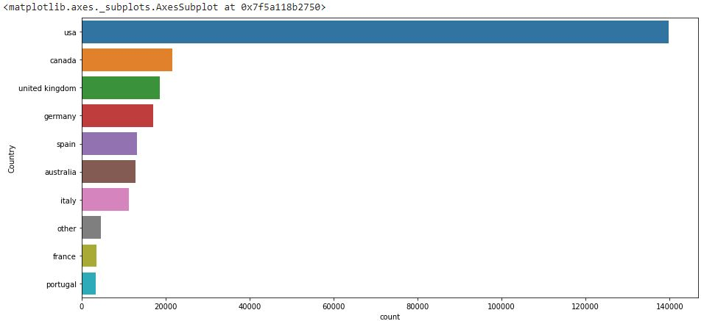
Observations from Users_df (Location)
Splitting Location column and analysing country.
Most active readers are from USA.

Slide 8
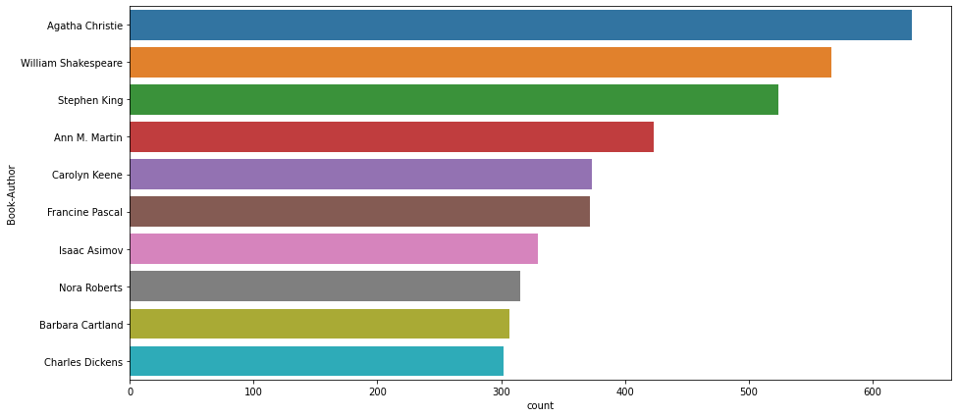
Observations from Book_df (Authors)
Agatha Christie wrote highest number of books in our given dataset

Slide 9
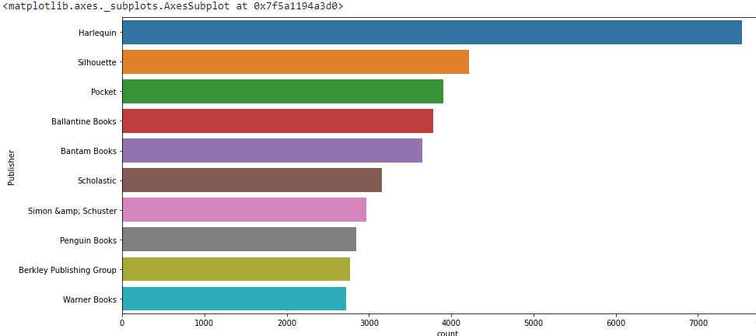
Observations from Book_df (Publishers)
Harlequin published highest number of books in our given dataset

Slide 10
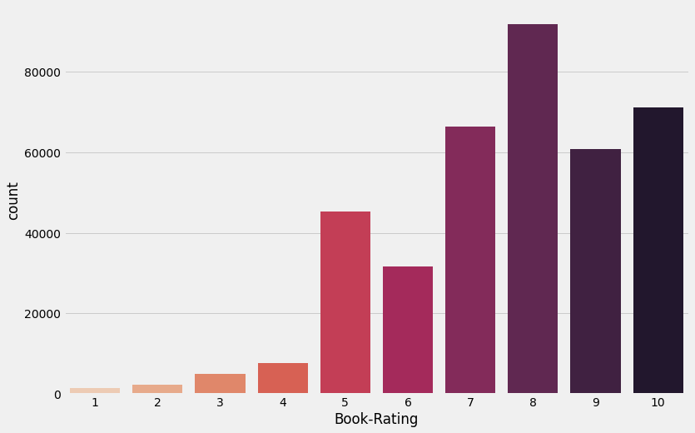
Observations from Ratings_df (Book_Rating)
Higher ratings are more common amongst users
Rating 8 has been rated the highest number of times

Slide 11
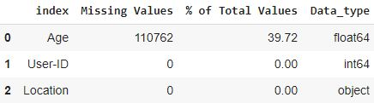
Data Cleaning
Null Value Imputation:
Age column has 40% missing values

Slide 12
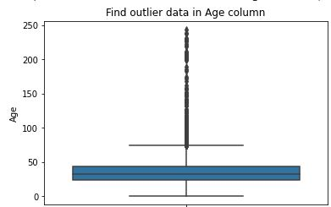
Imputing missing values
Outliers in Age column
Age has positive Skewness (right tail) so we can use median to fill Nan values,

Slide 13
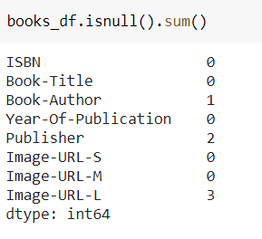
Data Cleaning
Null Value Imputation:

Slide 14
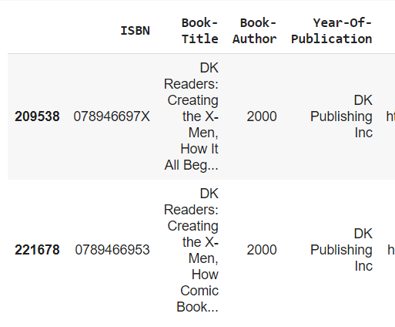
Replacing strings by int values

Slide 15
Different Models
1.)Popularity Based Recommendation
Book weighted average formula:
Weighted Rating(WR)=[vR/(v+m)]+[mC/(v+m)]
Where,
v is the number of votes for the books;
m is the minimum votes required to be listed in the chart;
R is the average rating of the book; and
C is the mean vote across the whole report.

Slide 16
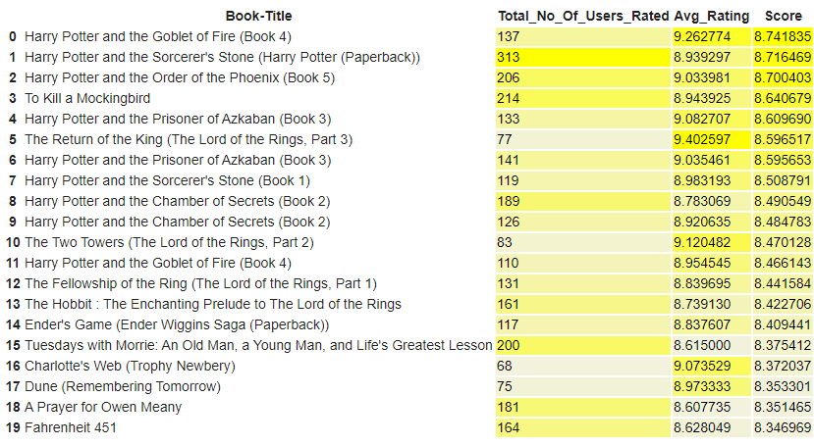
Different Models

Slide 17
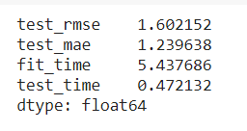
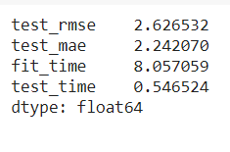
Different Models
2.)Model based collaborative filtering
SVD
NMF

Slide 18
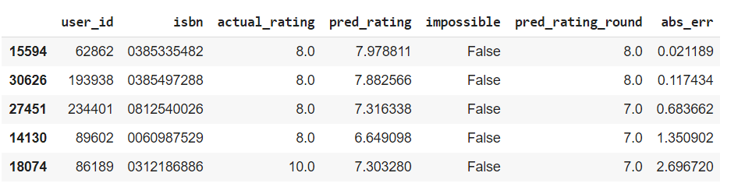
Different Models
SVD Model Results

Slide 19
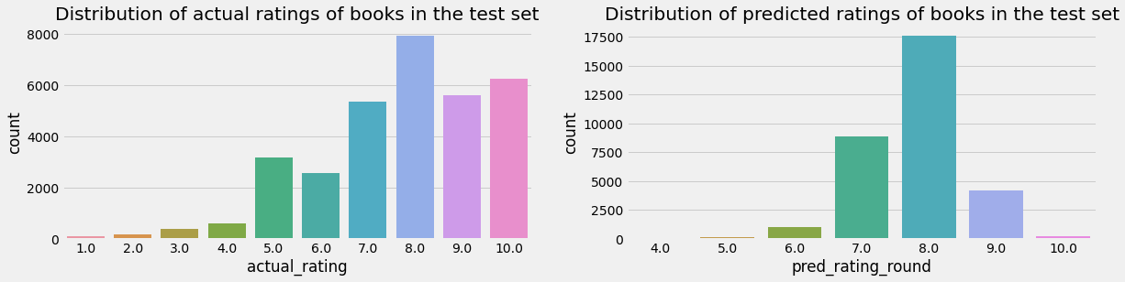
Different Models
SVD Model Results

Slide 20
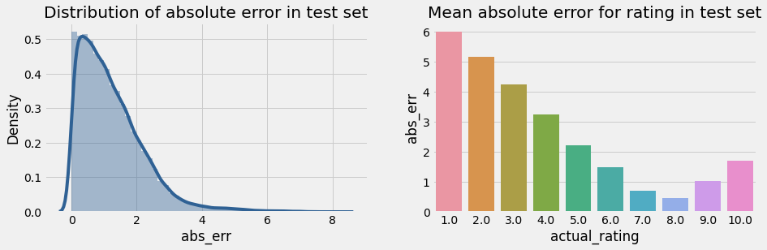
Different Models
SVD Model Results

Slide 21

Different Models
User-ID - 193458
Test set: predicted top rated books

Slide 22

Different Models
Test set: actual top rated books

Slide 23
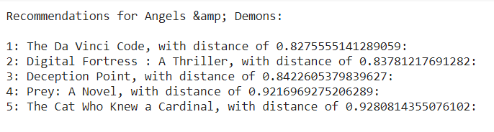
Collaborative Filtering-(Item-Item based)
3.)Collaborative Filtering-(Item-Item based)
Cosine Similarity
Nearest Neighbour

Slide 24


Different Models
SVD and Correlation
Recommendations for Harry Potter and the Sorcerer's Stone (Book 1)
Input
Output

Slide 25
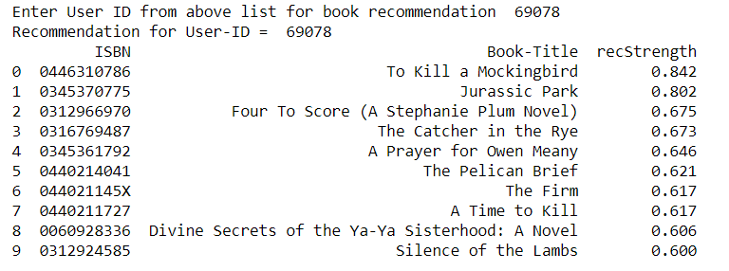
Different Models
4.)Collaborative Filtering-(User-Item based)

Slide 26
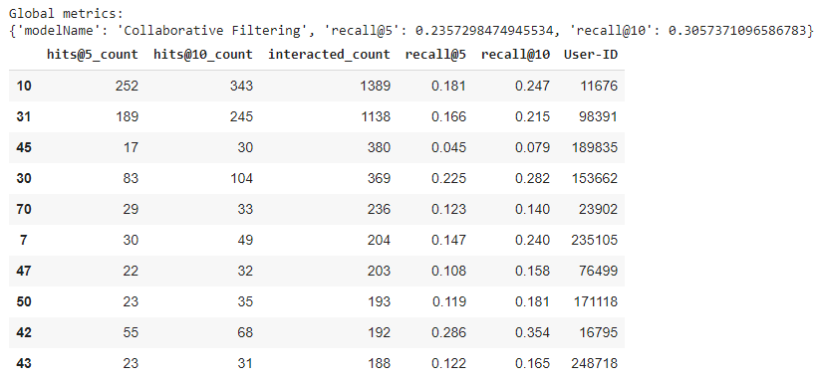
Different Models
Model Results

Slide 27
Conclusion
In EDA, the Top-10 most rated books were essentially novels. Books like The Lovely Bone and The Secret Life of Bees were very well perceived.
Majority of the readers were of the age bracket 20-35 and most of them came from North American and European countries namely USA, Canada, UK, Germany and Spain.
If we look at the ratings distribution, most of the books have high ratings with maximum books being rated 8. Ratings below 5 are few in number.
Author with the most books was Agatha Christie, William Shakespeare and Stephen King.
For modelling, it was observed that for model based collaborative filtering SVD technique worked way better than NMF with lower Mean Absolute Error (MAE) .

Slide 28
Challenges
Handling of sparsity was a major challenge as well since the user interactions were not present for the majority of the books.
Understanding the metric for evaluation was a challenge as well.
Since the data consisted of text data, data cleaning was a major challenge in features like Location etc..
Decision making on missing value imputations and outlier treatment was quite challenging as well.

Slide 29
Future Scope
Given more information regarding the books dataset, namely features like Genre, Description etc, we could implement a content-filtering based recommendation system and compare the results with the existing collaborative-filtering based system.
We would like to explore various clustering approaches for clustering the users based on Age, Location etc., and then implement voting algorithms to recommend items to the user depending on the cluster into which it belongs.

Slide 30
Thank You
Q & A

